Slide 1
Streaming
Chenting Zhang, Changrong Li, Duc Minh Pham

Slide 2
Overview

Slide 3



Overview
Traditional batch processing
Spark Streaming
Unable to handle the continuous data
Real time analysis:
modern applications, and device systems
Streaming
Apache Kafka
Literature List:
[1]A Survey on the Evolution of Stream Processing Systems. T. Akidau, S. Chernyak, and R. Lax.
[2]Discretized Streams: Fault-Tolerant Streaming Computation at Scale. M. Zaharia, T. Das, H. Li, T. Hunter, S. Shenker, and I. Stoica,
[3]Kafka - A Distributed Messaging System for Log Processing. N. Narkhede, J. Rao, and J. Kreps
[4]The Dataflow Model: A Practical Approach to Balancing Correctness, Latency, and Cost in Massive-Scale, Unbounded, Out-of-Order Data Processing. M. F. Dolz, P. Th. Eugster, and O. Nierstrasz.
[5]Structured Streaming - A Declarative API for Real-Time Applications in Apache Spark,” M. Armbrust et al.
Google Dataflow Model

Slide 4
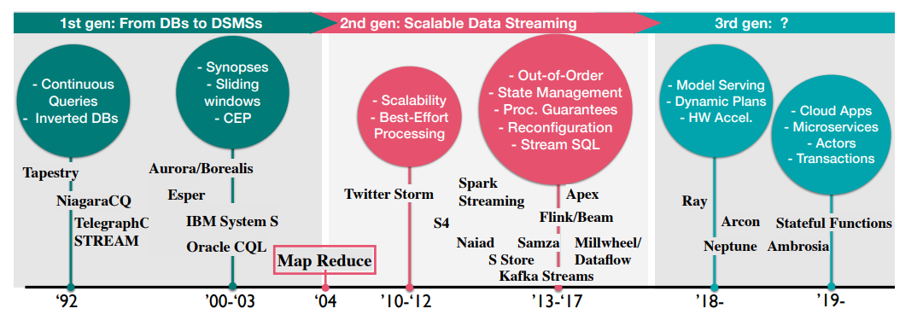
The evolution of Streaming
[1] "A Survey on the Evolution of Stream Processing Systems" <T. Akidau, S. Chernyak, and R. Lax>

Slide 5
D-Stream and Spark Streaming

Slide 6
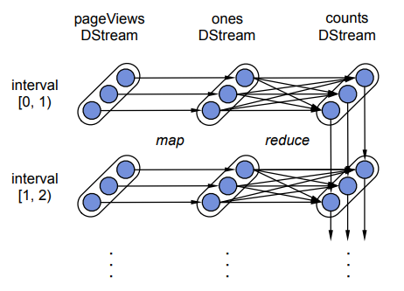
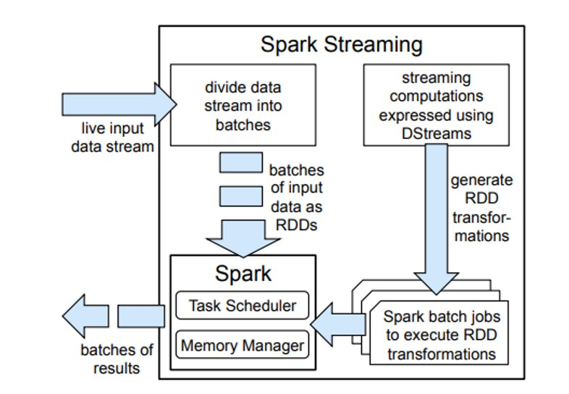
D-Stream and Spark Streaming
D-Stream: a new streaming structure
A D-Stream is a sequence of immutable, partitioned datasets (RDDs)
Low latency: Keeps data in memory
Fault tolerance: parallel recovery by racking the lineage graph of operations that were used to build it
All state in Spark Streaming is stored in fault-tolerant data structures (RDDs)
Figure: Lineage graph for RDDs
Figure: High-level overview of the Spark Streaming system

Slide 7
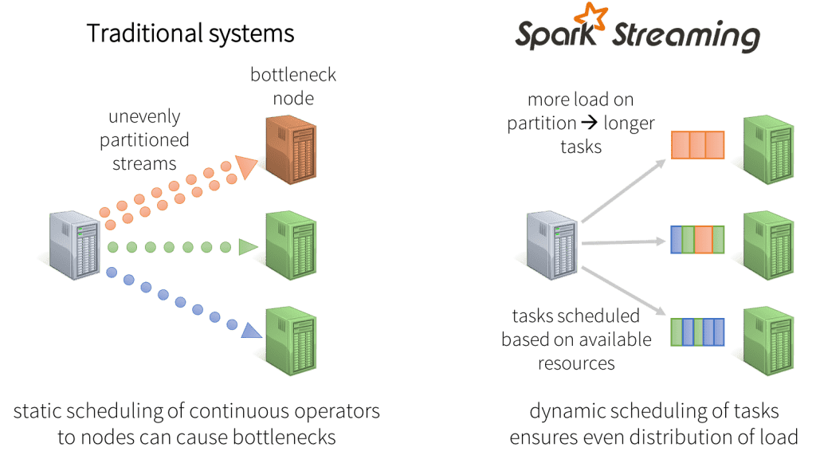
Spark Streaming
System Architecture
A master that tracks the D-Stream lineage graph and schedules tasks to compute new RDD partitions.
Worker nodes that receive data, store the partitions of input and computed RDDs, and execute tasks.
A client library used to send data into the system

Slide 8
Apache Kafka

Slide 9
Kafka: Processing Massive Log Data Streams
# The motivation of Kafka
Processing huge volumes of log data streams
Clicks, searches, page views, and mouse hoverings
Real-time and offline processing
# Tradditional Messaging Systems
Scalability and performance Issues
Low throughput
Weak in distributed support
Small message queues
Complexity of Enterprise Systems
Delivery gurantees

Slide 10
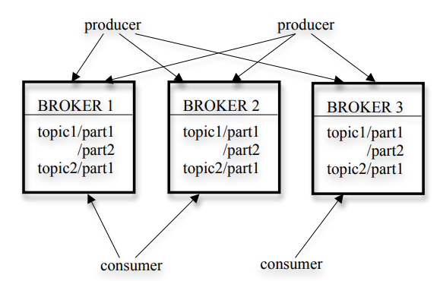
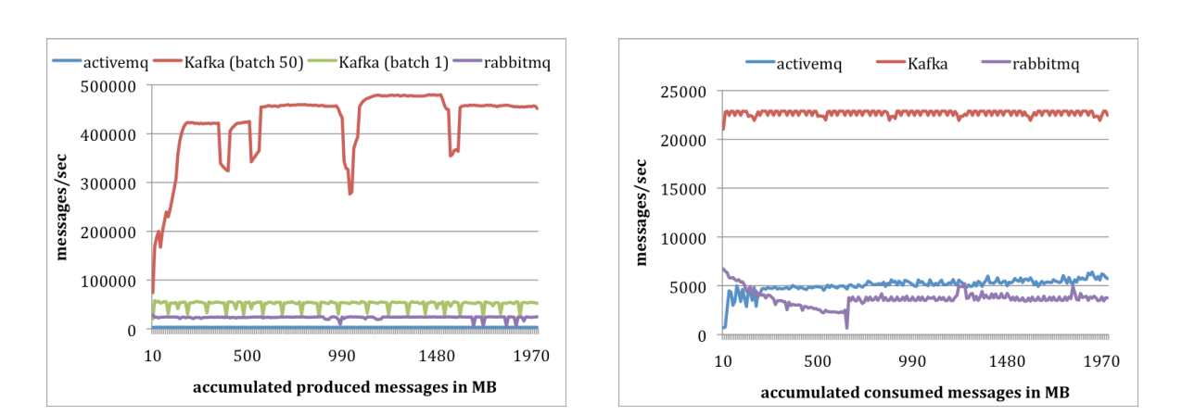
Key Features of Kafka
# Publish-Subscribe Model
Avoid being flooded at consumers ‘ side
Load balancing
# ZooKeeper to manage brokers
# Stateless brokers
# At-least-once delivery
# Accumulates hundreds of
gigabytes of data and close to
a billion messages per day

Slide 11
Google Dataflow Model

Slide 12
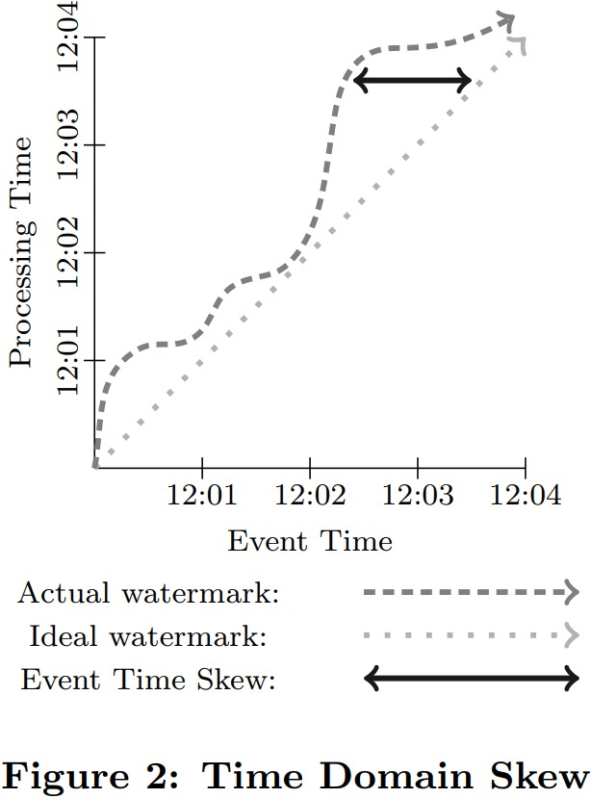
Google Dataflow Model: Challenges and Approach
Challenges:
Ensuring compatibility with other streaming systems.
Handling windowing based on processing time and tuples.
Sending unaligned results based on event time.
Historical Solutions: Lambda architecture.
Dataflow's Approach:
Use of Triggers with specific operations.
Discarding
Accumulating
Accumulating and Retracting.

Slide 13
Google Dataflow Model: Balancing Data Processing
Key Highlights:
Trade-offs among correctness, latency, and cost.
Unification of Batch/Streaming for Unbounded Datasets.
Watermark: Addressing Event Time vs. Processing Time skew.
Decoupling logical and physical data processing concepts.
Influences:
Influence on Apache Spark and Apache Flink developments.

Slide 14
Thank you for listening

